Slide 1
Chapter 7 Hypothesis Testing
7.1. Basics of Hypothesis Testing
7.2. Testing a Claim about a Proportion
7.3. Testing a Claim About a Mean

Slide 2
Example
Assume that 100 babies are born to 100 couples treated with the XSORT method of gender selection that is claimed to make girls more likely. We observe 58 girls in 100 babies. Can we state “with the XSORT method, the proportion of girls is greater than the 50% that occurs without any treatment”?

Slide 3
7.1. Basics of Hypothesis Testing
This section presents individual components of a hypothesis test. We should know and understand the following:
How to identify the null hypothesis (giả thuyết không) and alternative hypothesis (đối thuyết) from a given claim, and how to express both in symbolic form
How to calculate the value of the test statistic, given a claim and sample data
How to choose the sampling distribution that is relevant
How to identify the P-value or identify the critical value(s)
How to state the conclusion about a claim in simple and nontechnical terms

Slide 4
Definitions
A hypothesis is a claim or statement about a property of a population.
A hypothesis test (kiểm định giả thuyết) is a procedure for testing a claim about a property of a population.

Slide 5
Rare Event Rule for Inferential Statistics
If, under a given assumption, the probability of a particular observed event is exceptionally small, we conclude that the assumption is probably not correct.

Slide 6
Null Hypothesis
The null hypothesis (denoted by H₀) is a statement that the value of a population parameter (such as proportion, mean, or standard deviation) is equal to some claimed value.
We test the null hypothesis directly in the sense that we assume it is true and reach a conclusion to either reject H₀ or fail to reject H₀.

Slide 7
Alternative Hypothesis
The alternative hypothesis (denoted by H₁ or H_{A}) is the statement that the parameter has a value that somehow differs from the null hypothesis.
The symbolic form of the alternative hypothesis must use one of these symbols: <, >, ≠.

Slide 8
Note about Forming Your Own Claims (Hypotheses)
If you are conducting a study and want to use a hypothesis test to support your claim, the claim must be worded so that it becomes the alternative hypothesis.

Slide 9
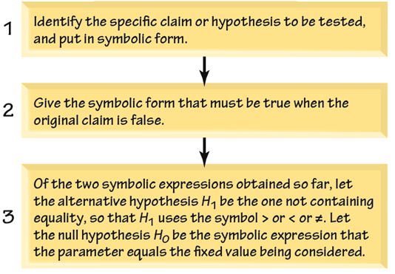
Steps 1, 2, 3: Identifying H₀ and H₁

Slide 10
Example
Assume that 100 babies are born to 100 couples treated with the XSORT method of gender selection that is claimed to make girls more likely.
We observe 58 girls in 100 babies. Write the hypotheses to test the claim the “with the XSORT method, the proportion of girls is greater than the 50% that occurs without any treatment”.

Slide 11
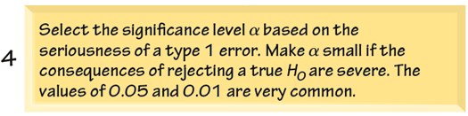
Step 4: Select the Significance Level α

Slide 12
Significance Level
The significance level (denoted by α, mức ý nghĩa) is the probability that the test statistic will fall in the critical region when the null hypothesis is actually true (making the mistake of rejecting the null hypothesis when it is true).
Common choices for α are 0.05, 0.01, and 0.10.

Slide 13
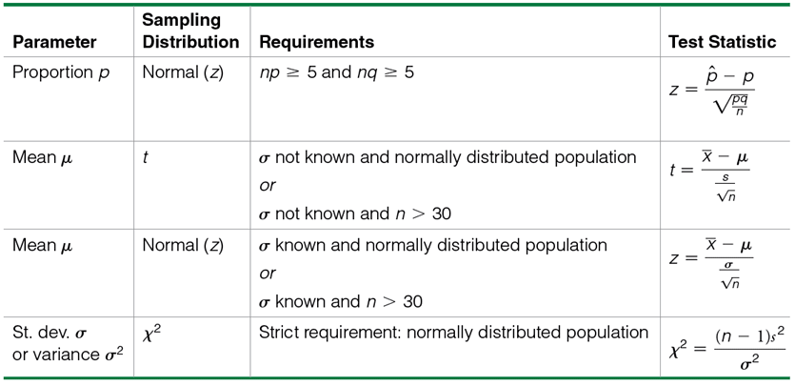
Step 5: Identify the Test Statistic and Determine its Sampling Distribution

Slide 14
Test Statistic
The test statistic is a value used in making a decision about the null hypothesis, and is found by converting the sample statistic to a score with the assumption that the null hypothesis is true.

Slide 15
Step 6: Find the Value of the Test Statistic, Then Find Either the P-Value or the Critical Value(s)
First transform the relevant sample statistic to a standardized score called the test statistic.
Then find the P-Value or the critical value(s).

Slide 16
Example
Let’s again consider the claim that the XSORT method of gender selection increases the likelihood of having a baby girl.
Preliminary results from a test of the XSORT method of gender selection involved 100 couples who gave birth to 58 girls and 42 boys.
Use the given claim and the preliminary results to calculate the value of the test statistic.
Use the format of the test statistic given above, so that a normal distribution is used to approximate a binomial distribution.

Slide 17
Example - Continued
The claim that the XSORT method of gender selection increases the likelihood of having a baby girl results in the following null and alternative hypotheses:
We work under the assumption that the null hypothesis is true with p = 0.5.
The sample proportion of 58 girls in 10 births results in:

Slide 18
Example – Convert to the Test Statistic
We know from previous chapters that a z score of 1.60 is not “unusual”.
At first glance, 58 girls in 100 births does not seem to support the claim that the XSORT method increases the likelihood a having a girl (more than a 50% chance).

Slide 19
Types of Hypothesis Tests: Two-tailed, Left-tailed, Right-tailed
The tails in a distribution are the extreme regions bounded by critical values.
Determinations of P-values and critical values are affected by whether a critical region is in two tails, the left tail, or the right tail. It, therefore, becomes important to correctly, characterize a hypothesis test as two-tailed, left-tailed, or right-tailed.

Slide 20
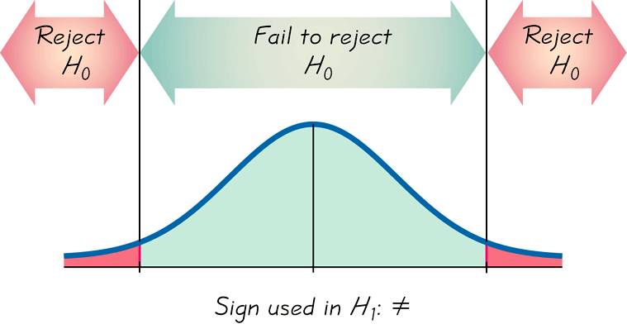
Two-tailed Test
α is divided equally between the two tails of the critical region

Slide 21
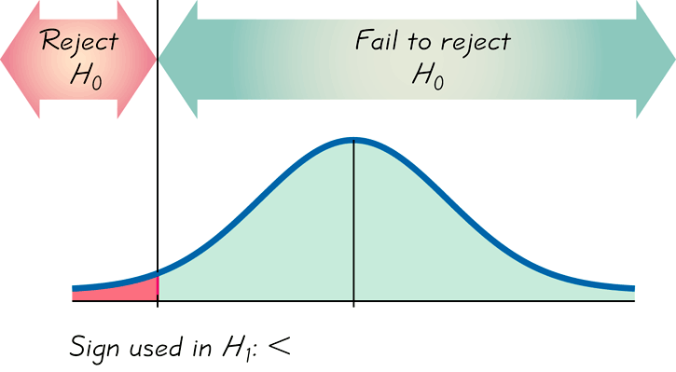
Left-tailed Test
All α in the left tail

Slide 22
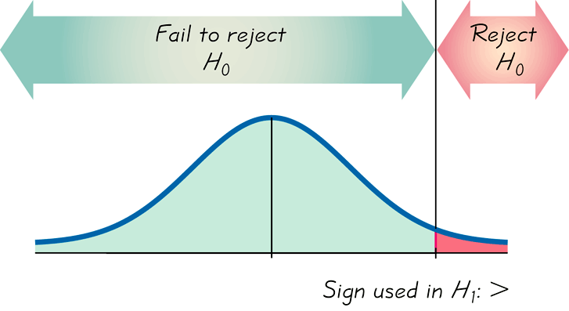
Right-tailed Test
All α in the right tail

Slide 23
P-Value
The P-value (or probability value) is the probability of getting a value of the test statistic that is at least as extreme as the one representing the sample data, assuming that the null hypothesis is true.
Critical region in the left tail:
P-value = area to the left of the test statistic
Critical region in the right tail:
P-value = area to the right of the test statistic
Critical region in two tails:
P-value = twice the area in the tail beyond the test statistic

Slide 24
P-Value
The null hypothesis is rejected if the P-value is very small, such as 0.05 or less.

Slide 25
Example
The claim that the XSORT method of gender selection increases the likelihood of having a baby girl results in the following null and alternative hypotheses:
The test statistic was :

Slide 26
Example
The test statistic of z = 1.60 has an area of 0.0548 to its right, so a right-tailed test with test statistic z = 1.60 has a P-value of 0.0548

Slide 27
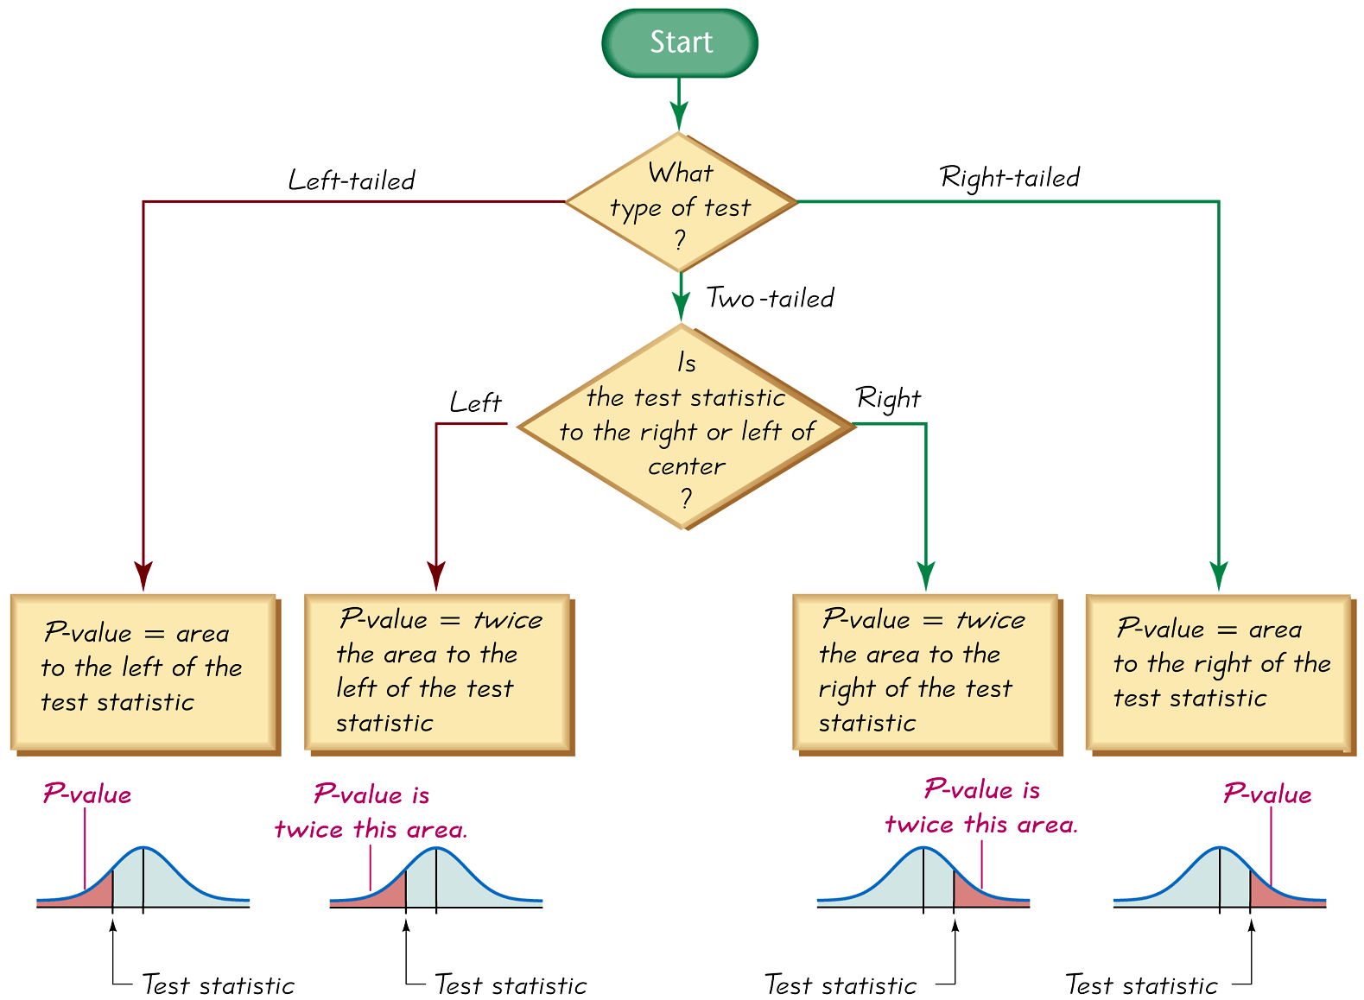
Procedure for Finding P-Values

Slide 28
Critical Region
The critical region (or rejection region, miền bác bỏ) is the set of all values of the test statistic that cause us to reject the null hypothesis. For example, see the red-shaded region in the previous figures.

Slide 29
Critical Value
A critical value is any value that separates the critical region (where we reject the null hypothesis) from the values of the test statistic that do not lead to rejection of the null hypothesis.
The critical values depend on the nature of the null hypothesis, the sampling distribution that applies, and the significance level α.

Slide 30
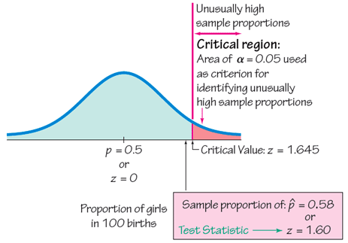
Example
For the XSORT birth hypothesis test, the critical value and critical region for an α = 0.05 test are shown below:

Slide 31
Caution
Don’t confuse a P-value with a proportion p.
Know this distinction:
P-value = probability of getting a test statistic at least as extreme as the one representing sample data
p = population proportion

Slide 32
Step 7 : Make a Decision: Reject H₀ or Fail to Reject H₀
The methodologies depend on if you are using the P-Value method or the critical value method.

Slide 33
Decision Criterion
P-value Method:
Using the significance level α:
If P-value ≤ α, reject H₀.
If P-value > α, fail to reject H₀.

Slide 34
Decision Criterion
Critical Value Method:
If the test statistic falls within the critical region, reject H₀.
If the test statistic does not fall within the critical region, fail to reject H₀.

Slide 35
Example
For the XSORT baby gender test, the test had a test statistic of z = 1.60 and a P-Value of 0.0548. We tested:
Using the P-Value method, we would fail to reject the null at the α = 0.05 level.
Using the critical value method, we would fail to reject the null because the test statistic of z = 1.60 does not fall in the rejection region.
(You will come to the same decision using either method.)

Slide 36
Step 8 : Restate the Decision Using Simple and Nontechnical Terms
State a final conclusion that addresses the original claim with wording that can be understood by those without knowledge of statistical procedures.

Slide 37
Example
For the XSORT baby gender test, there was not sufficient evidence to support the claim that the XSORT method is effective in increasing the probability that a baby girl will be born.

Slide 38
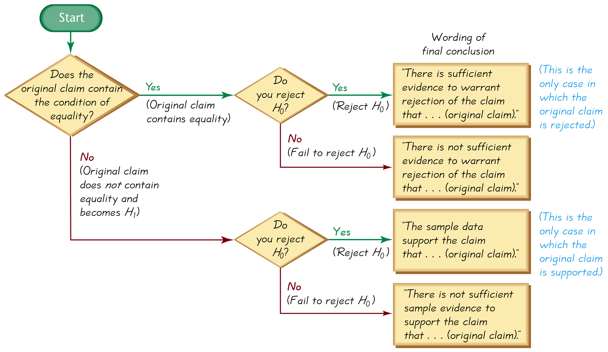
Wording of Final Conclusion

Slide 39
Caution
Never conclude a hypothesis test with a statement of “reject the null hypothesis” or “fail to reject the null hypothesis.”
Always make sense of the conclusion with a statement that uses simple nontechnical wording that addresses the original claim.

Slide 40
Accept Versus Fail to Reject
Some texts use “accept the null hypothesis.”
We are not proving the null hypothesis.
Fail to reject says more correctly that the available evidence is not strong enough to warrant rejection of the null hypothesis.

Slide 41
Type I Error
A Type I error is the mistake of rejecting the null hypothesis when it is actually true.
The symbol α is used to represent the probability of a type I error.
Notes:
page 398 of Elementary Statistics, 10th Edition

Slide 42
Type II Error
A Type II error is the mistake of failing to reject the null hypothesis when it is actually false.
The symbol β (beta) is used to represent the probability of a type II error.
Notes:
Page 398 of Elementary Statistics, 10th Edition

Slide 43
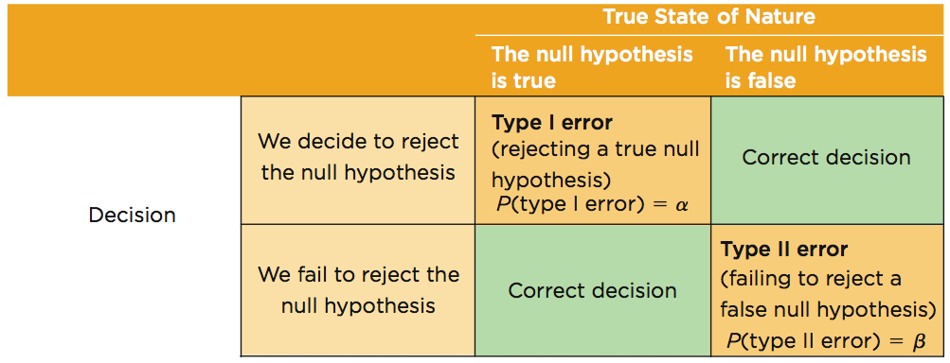
Type I and Type II Errors

Slide 44
Example
Assume that we are conducting a hypothesis test of the claim that a method of gender selection increases the likelihood of a baby girl, so that the probability of a baby girls is p > 0.5.
Here are the null and alternative hypotheses:
a) Identify a type I error.
b) Identify a type II error.

Slide 45
Example - Continued
a) A type I error is the mistake of rejecting a true null hypothesis:
We conclude the probability of having a girl is greater than 50%, when in reality, it is not. Our data misled us.
b) A type II error is the mistake of failing to reject the null hypothesis when it is false:
There is no evidence to conclude the probability of having a girl is greater than 50% (our data misled us), but in reality, the probability is greater than 50%.

Slide 46
Controlling Type I and Type II Errors
For any fixed α, an increase in the sample size n will cause a decrease in β.
For any fixed sample size n, a decrease in α will cause an increase in β. Conversely, an increase in α will cause a decrease in β.
To decrease both α and β, increase the sample size.

Slide 47
Part 2: Beyond the Basics of Hypothesis Testing: The Power of a Test

Slide 48
Definition
The power of a hypothesis test is the probability 1 – β of rejecting a false null hypothesis.
The value of the power is computed by using a particular significance level α and a particular value of the population parameter that is an alternative to the value assumed true in the null hypothesis.

Slide 49
Power and the Design of Experiments
Just as 0.05 is a common choice for a significance level, a power of at least 0.80 is a common requirement for determining that a hypothesis test is effective. (Some statisticians argue that the power should be higher, such as 0.85 or 0.90.)
When designing an experiment, we might consider how much of a difference between the claimed value of a parameter and its true value is an important amount of difference.
When designing an experiment, a goal of having a power value of at least 0.80 can often be used to determine the minimum required sample size.

Slide 50
7.2. Testing a Claim about a Proportion
Example: Testing a hypothesis (or claim) made about a population proportion, uses the following methods:
1) The P-value method
2) The traditional method
Group: 1, 4, 7, 10, 13

Slide 51
7.3. Testing a Claim About a Mean
Example: Testing a hypothesis (or claim) made about a mean proportion (σ is not known), uses the following methods:
1) The P-value method
2) The traditional method
Group: 2, 5, 8, 11, 14

Slide 52
7.3. Testing a Claim About a Mean
Example: Testing a hypothesis (or claim) made about a mean proportion (σ is known), uses the following methods:
1) The P-value method
2) The traditional method
Group: 3, 6, 9, 12

